Slide 1

SMART PARKING SYSTEM
BY THE RECTIFIERS
( CHARU, NIPUN TULSIAN, ANUPAMA, SAJJA)

Slide 2

INTRODUCTION
Currently, the development of automotive
technology is growing rapidly, this emerges based on
ideas and needs of people who are also growing
rapidly. Based on this notion, the application of
technology in the automotive milieu continues to
develop until the creation of sophisticated
technology is equal to changing times. The
development of a sensor system with the Internet of
Things (IoT) connectivity provides the development
of better driving technology, which supports the
growth of the automotive market. The application of
this technology provides security and convenience
for drivers and their vehicles.

Slide 3
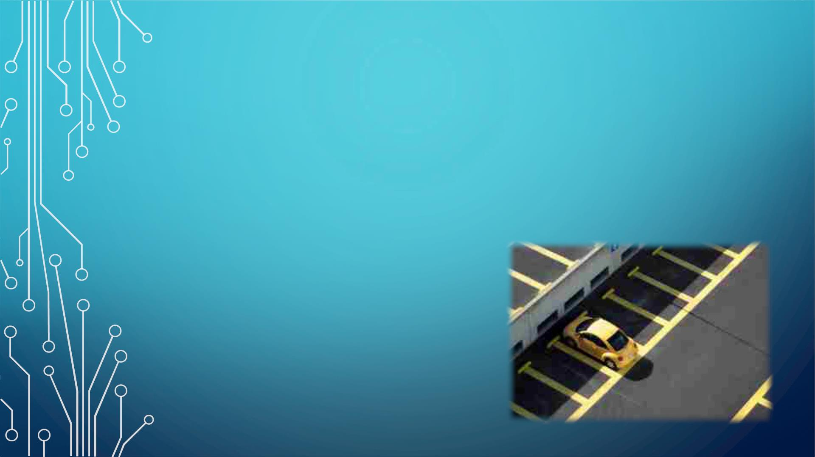
A parking assistant or parking distance detector is a technology
designed to prevent cars’ rear friction; this system is commonly
used in vehicles. A parking distance detector is installed on the
walls of the parking which detects the rear and warns the driver
before bumping or crashing the vehicle.

Slide 4
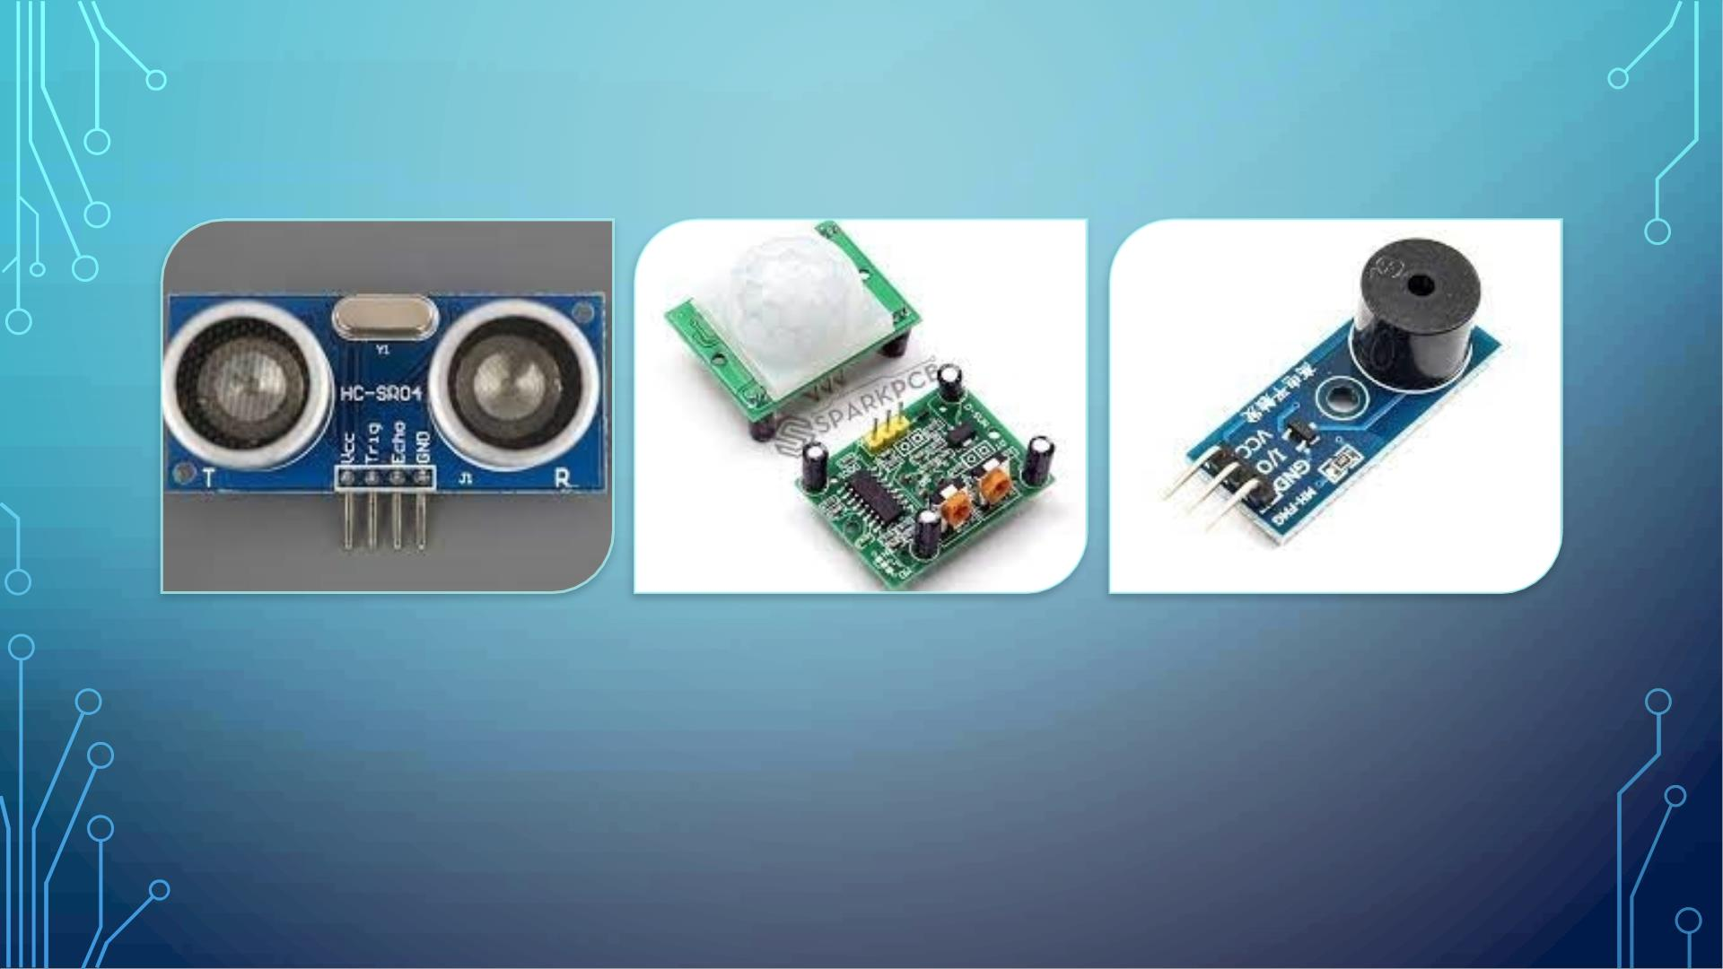
COMPONENTS REQUIRED
HC-SR04 ULTRASONIC SENSORS
PIR SENSOR
PIEZO BUZZER

Slide 5
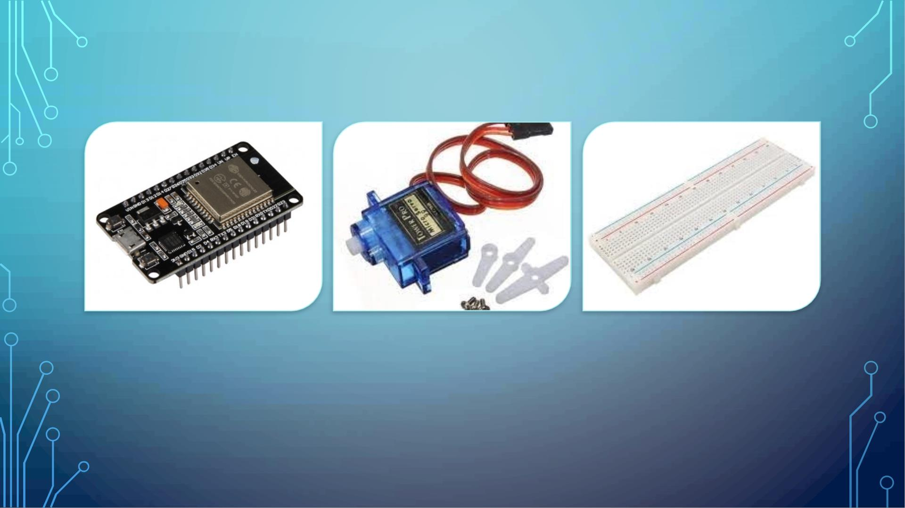
COMPONENTS REQUIRED
ESP32
SERVO MOTOR
BREADBOARD

Slide 6

SOFTWARE USED
• ONEM2M
• HTML
• CSS
• JAVASCRIPT
• THINGSPEAK

Slide 7

BLOCK DIAGRAM
EXIT GATE CONTROL
SERVO
MOTOR
PIR
SENSOR
ONEM2M AND
THINGSPEAK
PLATFORM
PARKING SLOTS
ULTRASONIC
SENSOR + BUZZER
ULTRASONIC
SENSOR + BUZZER
ESP 32
ULTRASONIC
SENSOR + BUZZER
END USER
(WEBPAGE)
ULTRASONIC
SENSOR + BUZZER
ENTRY GATE CONTROL
SERVO
PIR
MOTOR
SENSOR

Slide 8

PROBLEMS WITH THE EXISTING PARKING
SYSTEM
The problem with the current parking system is that the driver doesn’t know
whether a slot is empty or not in a parking space and also a lot of times drivers
end up bumping the cars due to disturbances or chaos in the parking area. With
the increase in the global human population, which implies increase in number of
vehicles has only aggravated the whole issues of parking slots and vehicle
safety.

Slide 9
PROJECT PLANNING
• Implementation of the proposed system (next few slides)
• To study software and hardware components
• Experimental setup
• Coding and checking the output
• Result

Slide 10
PART 1: EMPTY SLOT DETECTION
• The entry and exit barrier are made with the help of Servo motor.
• When a vehicle comes near the entry barrier, the PIR sensor detects its
presence.
• We have used onem2m and thingspeak platform for recording data(empty
slots)
• Any person coming to the parking can check the website at anytime of the
day to check the occupancy of the four slots.

Slide 11
• Then it takes the count of the vehicles already parked in the parking slots; if
count<4, the barrier opens and the car enters.
• If the count=4, then the barrier doesn’t open.
• The operation of the exit side will be same as entrance.
• The PIR sensor will detect the presence of vehicle in front of barrier and open
automatically.

Slide 12
PART 2: PARKING ASSISTANCE
• Once the vehicle enters the parking area and its respective slot, now it needs
assistance while in reverse gear to avoid bumping.
• When the vehicle enters the slot and reversing, the Ultrasonic sensors detect
the distance between the vehicle and the rear wall.
• Threshold distance has been set to 4cm; so whenever the distance between
the wall and rear of the vehicle is less than 4cm , the piezo buzzer starts
buzzing.

Slide 13
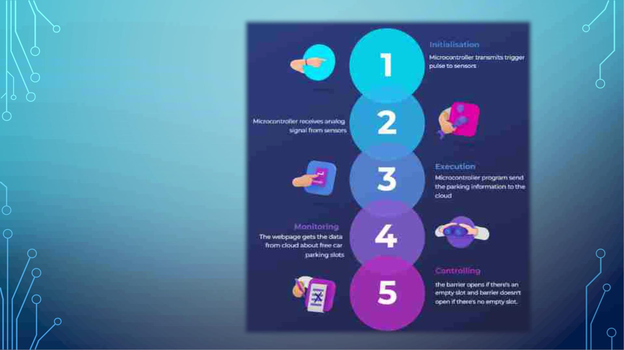
FLOWCHART

Slide 14
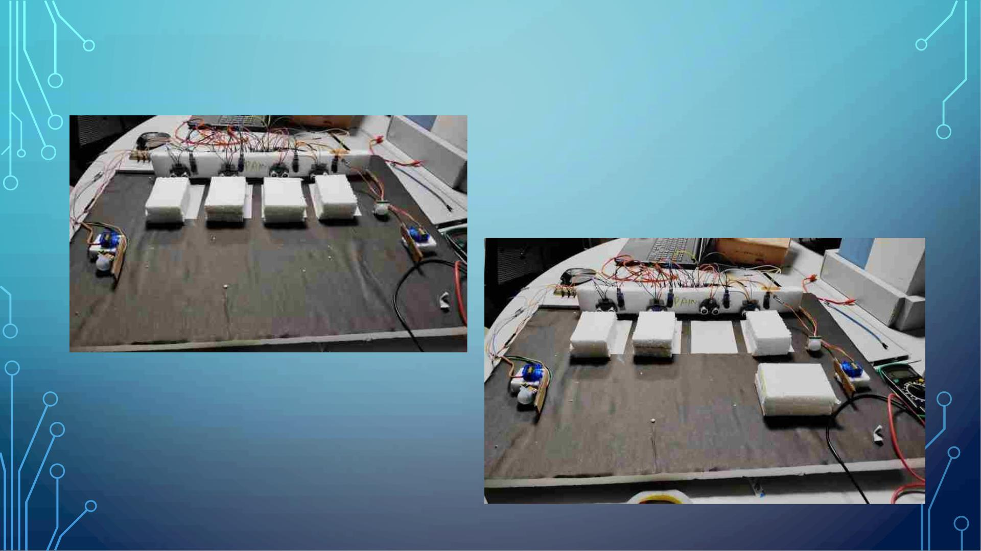
PROJECT IMAGES

Slide 15
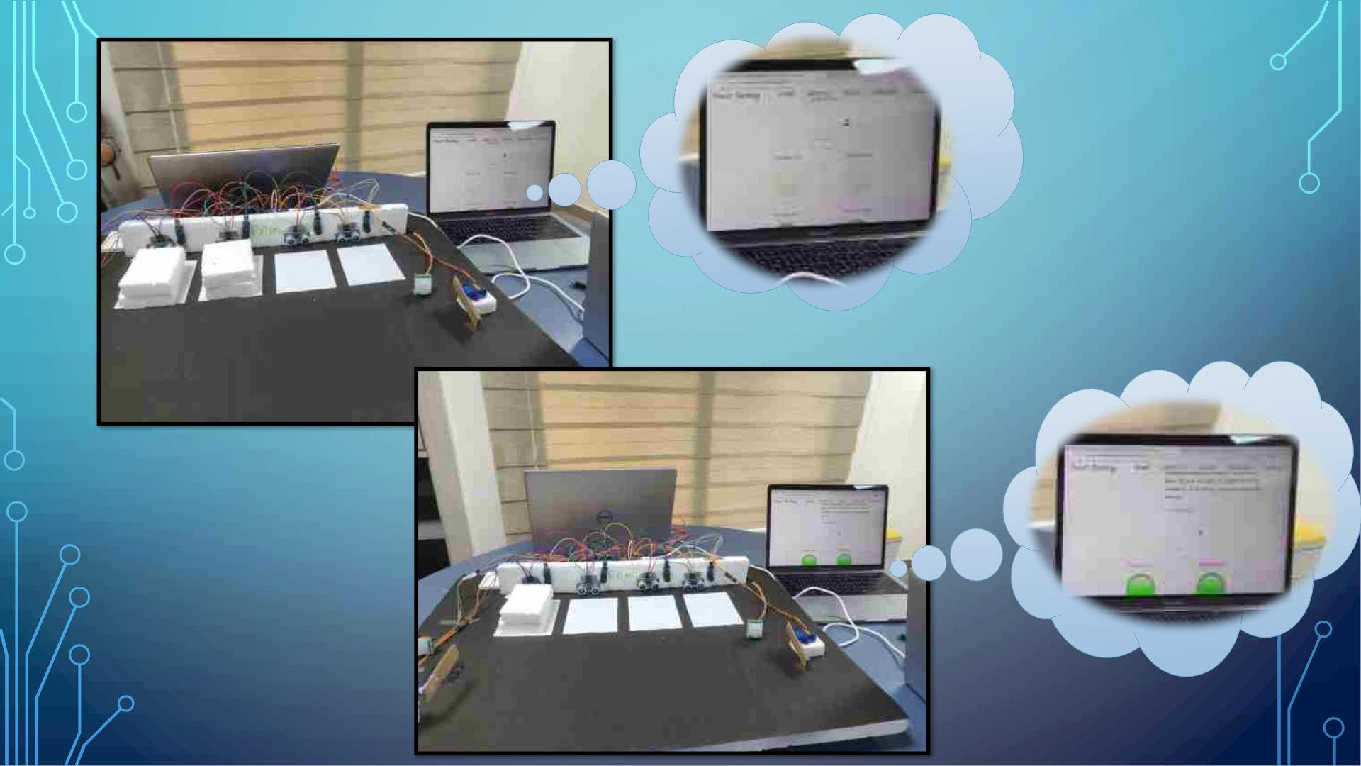

Slide 16
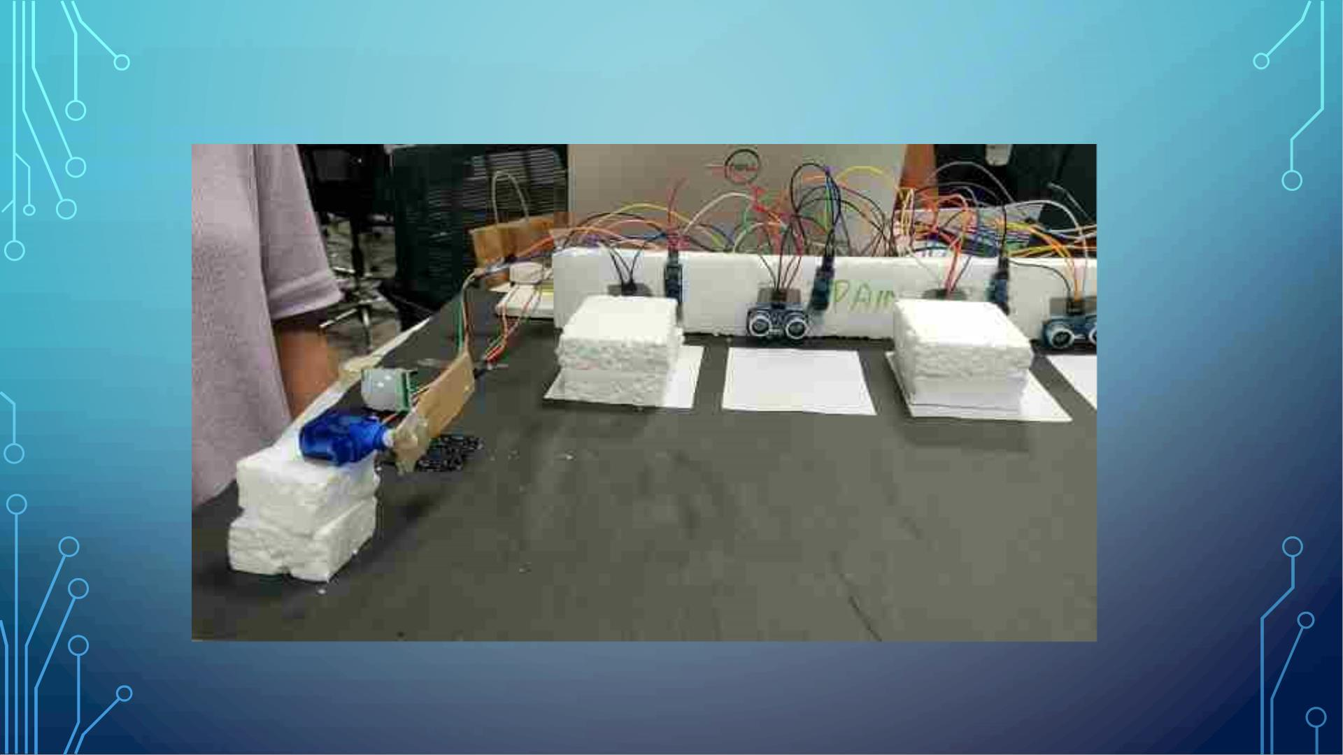
DEMO

Slide 17
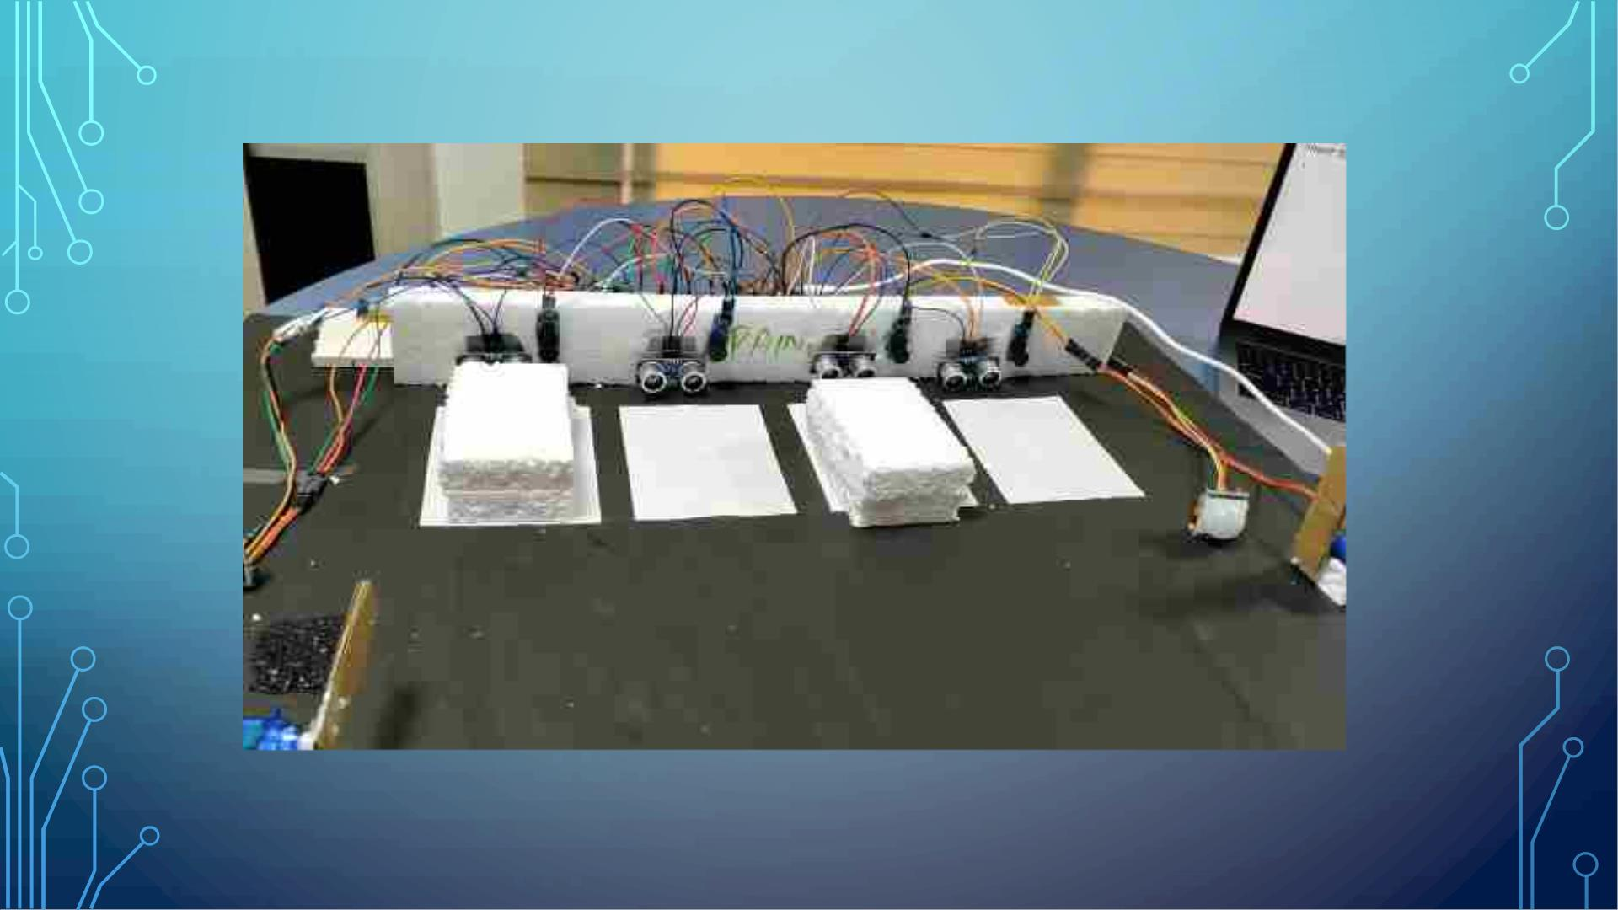
DEMO

Slide 18
BENEFITS OF SMART PARKING SYSTEM
1. Real-time monitoring of parking space.
2. Providing better control for consumers, businesses, and law enforcement
representatives
3. Optimizing space and time in a tight and busy urban environment
4. Foresee the flow of vehicles by analyzing parking routines in malls,
business stores, airports

Slide 19
APPLICATIONS OF THIS SYSTEM
The above smart parking assistance system can be used in various public
places to avoid chaos and save time and fuel.
1. Office
2. Theatres
3. Malls
4. Recreational parks
5. Hospitals

Slide 20
THANK YOU !!

